Slide 1
Introduction to Python
Professor Callison-Burch

Slide 2

Python
Developed by Guido van Rossum in the early 90s
Originally Dutch, in USA since 1995.
Benevolent Dictator for Life (now retired)
Named after the Monty Python comedy group
Download from python.org
Notes:
Guido van Rossum is the author of Python, an interpreted, interactive object-oriented programming language. In the late 1980s, Van Rossum began work on Python at the National Research Institute for Mathematics and Computer Science in the Netherlands where we worked on the programming language ABC. ABC was intended to be a programming language that could be taught to intelligent computer users who were not computer programmers or software developers in any sense. Instead the focus was on scientists like physicists or social scientists or linguists. Python is partially inspired by his work on the ABC programming language in the 80s. He started developing his own language in 1989. (http://pytalent.zandstrasystems.com/meet_py1.html)
In 1999, Van Rossum submitted a funding proposal to DARPA called "Computer Programming for Everybody", in which he further defined his goals for Python:
* An easy and intuitive language just as powerful as major competitors
* Open source, so anyone can contribute to its development
* Code that is as understandable as plain English
* Suitability for everyday tasks, allowing for short development times
From 2005-2012 Guido worked at Google where he spent half his time developing Python. Now he works at Dropbox.
In 2018, he announced that he would be stepping down from the position of BDFL of the Python programming language
(https://en.wikipedia.org/wiki/Guido_van_Rossum)

Slide 3
Some Positive Features of Python
Fast development:
Concise, intuitive syntax
Whitespace delimited
Garbage collected
Portable:
Programs run on major platforms without change
cpython: common Python implementation in C.
Various built-in types:
lists, dictionaries, sets: useful for AI
Large collection of support libraries:
NumPy for Matlab like programming
Sklearn for machine learning
Pandas for data analysis
Notes:
CPython is the reference implementation of the Python programming language. Written in C and Python, CPythonis the default and most widely-used implementation of the language. CPython can be defined as both an interpreter and a compiler as it compiles Python code into bytecode before interpreting it. https://en.wikipedia.org/wiki/CPython

Slide 4
Recommended Reading
Python Overview
The Official Python Tutorial (https://docs.python.org/3/tutorial/index.html)
Slides for CIS192 (https://cis192.github.io/schedule/)
PEPs – Python Enhancement Proposals
PEP 8 - Official Style Guide for Python Code (Guido et al)
Style is about consistency. 4 space indents, < 80 char lines
Naming convention for functions and variables: lower_w_under
Use the automatic pep8 checker!
PEP 20 – The Zen of Python (Tim Peters) (try: import this)
Beautiful is better than ugly; simple is better than complex
There should be one obvious way to do it
That way may not be obvious at first unless you're Dutch
Readability counts
Notes:
.

Slide 5
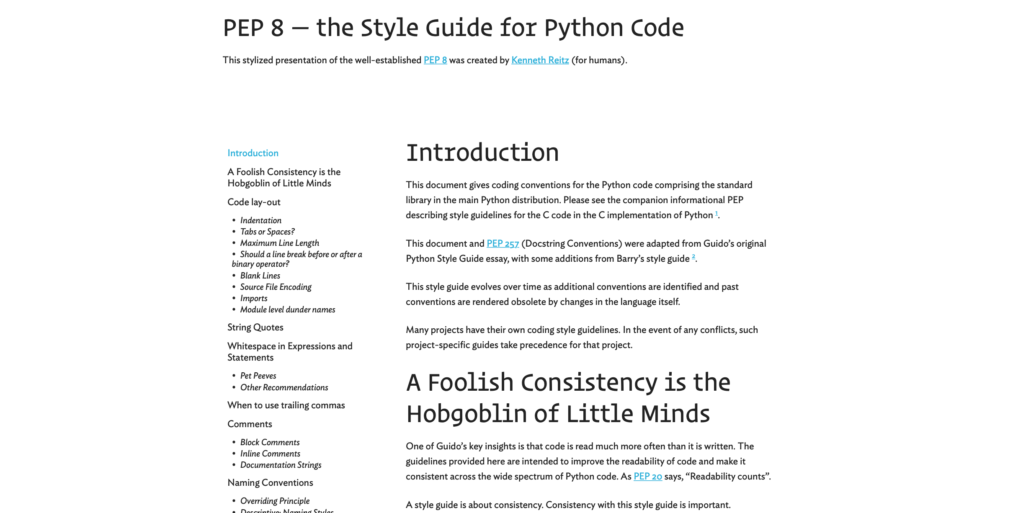

Slide 6
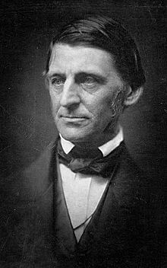
Ralph Waldo Emerson
“A foolish consistency is the hobgoblin of little minds, adored by little statesmen and philosophers and divines. With consistency a great soul has simply nothing to do. He may as well concern himself with his shadow on the wall. Speak what you think now in hard words, and tomorrow speak what tomorrow thinks in hard words again, though it contradict everything you said today. —'Ah, so you shall be sure to be misunderstood.'— Is it so bad, then, to be misunderstood? Pythagoras was misunderstood, and Socrates, and Jesus, and Luther, and Copernicus, and Galileo, and Newton, and every pure and wise spirit that ever took flesh. To be great is to be misunderstood.”

Slide 7
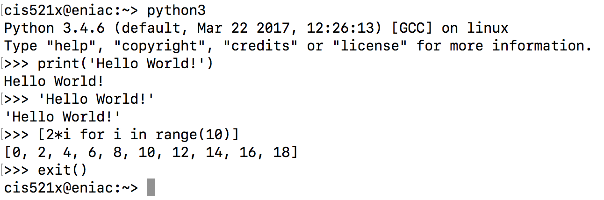
Python REPL Environment
REPL
Read-Evaluate-Print Loop
Type “python” at the terminal
Convenient for testing
If you’d like syntax highlighting in REPL try bpython
You should use Python version 3.7 or version 3.8.
Notes:
.

Slide 8
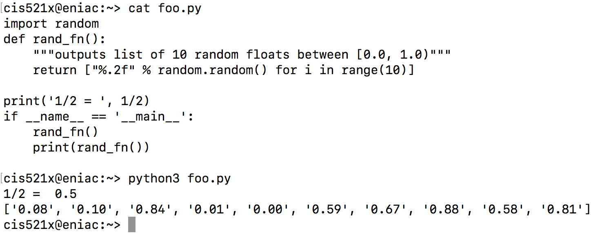
Python Scripts
Scripts
Create a file with your favorite text editor (like Sublime)
Type “python3 script_name.py” at the terminal to run
Not REPL, so you need to explicitly print
Notes:
.

Slide 9
PyCharm IDE
Notes:
.

Slide 10
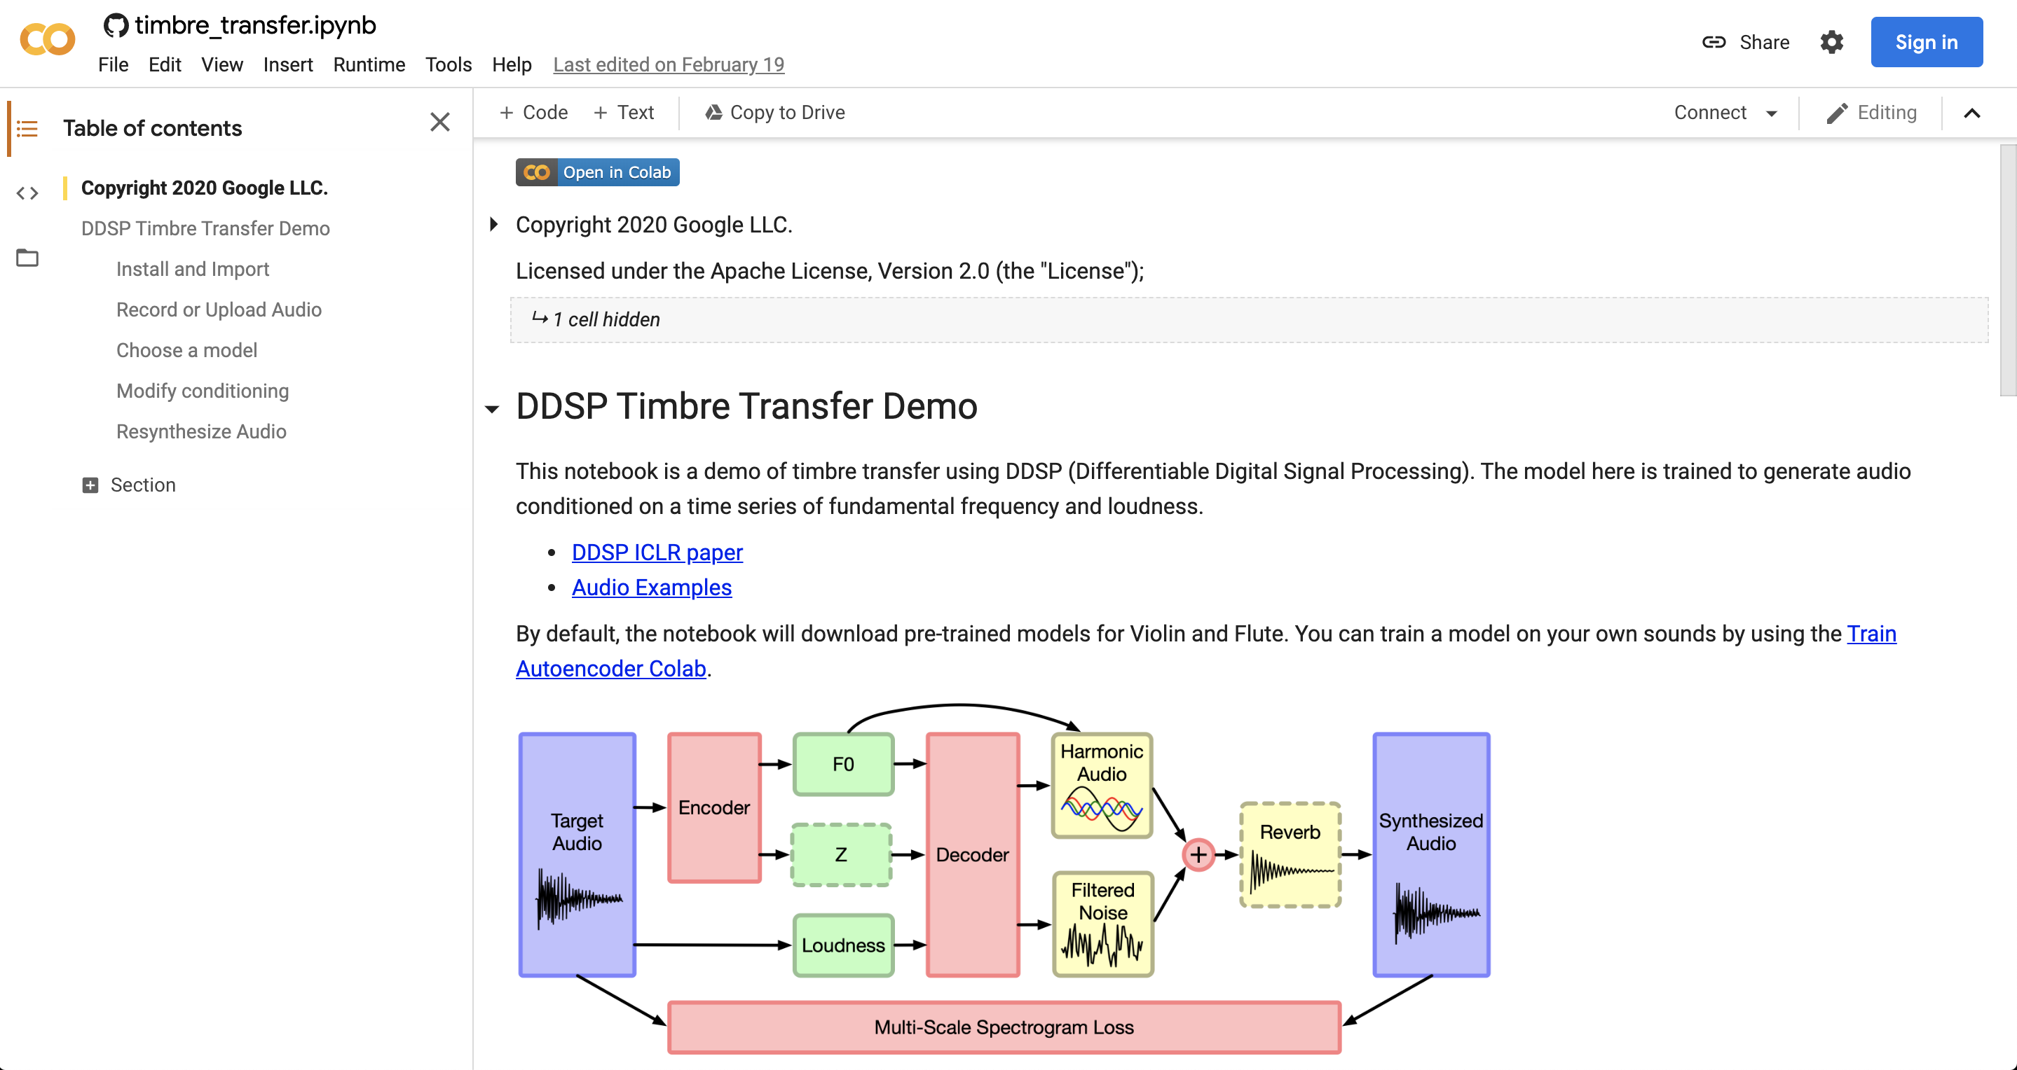
Python Notebooks
Jupyter Notebooks allow you to interactively run Python code in your web browser and share it with others in places like Google Colab
They are popular for tutorials since you can include inline text and images
Notes:
.

Slide 11
Structure of Python File
Whitespace is meaningful in Python
Use a newline to end a line of code.
Use \ when must go to next line prematurely.
Block structure is indicated by indentation
The first line with less indentation is outside of the block.
The first line with more indentation starts a nested block.
Often a colon appears at the end of the line of a start of a new block. (E.g. for function and class definitions.)
Notes:
.

Slide 12
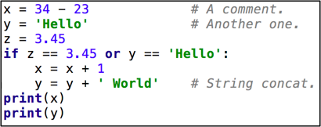
A Simple Code Sample
Notes:
Syntax highlighting in Pycharm

Slide 13
Objects and Types
All data treated as objects
An object is deleted (by garbage collection) once unreachable.
Strong Typing
Every object has a fixed type, interpreter doesn’t allow things incompatible with that type (eg. “foo” + 2)
type(object)
isinstance(object, type)
Examples of Types:
int, float
str, tuple, dict, list
bool: True, False
None, generator, function
Notes:
.

Slide 14
Static vs Dynamic Typing
Java: static typing
Variables can only refer to objects of a declared type
Methods use type signatures to enforce contracts
Python: dynamic typing
Variables come into existence when first assigned.
>>> x = "foo”
>>> x = 2
type(var) automatically determined
If assigned again, type(var) is updated
Functions have no type signatures
Drawback: type errors are only caught at runtime
Notes:
.

Slide 15
Math Basics
Literals
Integers: 1, 2
Floats: 1.0, 2e10
Boolean: True, False
Operations
Arithmetic: + - * /
Power: **
Modulus: %
Comparison: , <=, >=, ==, !=
Logic: (and, or, not) not symbols
Assignment Operators
+= *= /= &= ...
No ++ or --
Notes:
.

Slide 16
Strings
Creation
Can use either single or double quotes
Triple quote for multiline string and docstring
Concatenating strings
By separating string literals with whitespace
Special use of ‘+’
Prefixing with r means raw.
No need to escape special characters: r’\n’
String formatting
Special use of ‘%’ (as in printf in C)
print("%s can speak %d languages" % ("C3PO", 6000000))
Immutable
Notes:
String formatting options: https://www.python-course.eu/python3_formatted_output.php

Slide 17
References and Mutability
>>> x = 'foo '
>>> y = x
>>> x = x.strip() # new obj
>>> x
'foo'
>>> y
'foo '
strings are immutable
== checks whether variables point to objects of the same value
is checks whether variables point to the same object
>>> x = [1, 2, 3, 4]
>>> y = x
>>> x.append(5) #same obj
>>> y
[1, 2, 3, 4, 5]
>>> x
[1, 2, 3, 4, 5]
lists are mutable
use y = x[:] to get a (shallow) copy of any sequence, ie. a new object of the same value
Notes:
.

Slide 18

Sequence types: Tuples, Lists, and Strings
Notes:
.

Slide 19
Sequence Types
Tuple
A simple immutable ordered sequence of items
Immutable: a tuple cannot be modified once created
Items can be of mixed types, including collection types
Strings
Immutable
Very much like a tuple with different syntax
Regular strings are Unicode and use 2-byte characters (Regular strings in Python 2 use 8-bit characters)
List
Mutable ordered sequence of items of mixed types
Notes:
.

Slide 20
Sequence Types
The three sequence types share much of the same syntax and functionality.
>>> tu = (23, 'abc', 4.56, (2,3), 'def') # tuple
>>> li = ['abc', 34, 4.34, 23] # list
>>> st = "Hello World"; st = 'Hello World' # strings
>>> tu[1] # Accessing second item in the tuple.
'abc'
>>> tu[-3] #negative lookup from right, from -1
4.56
Notes:
.

Slide 21
Slicing: Return Copy of a Subsequence
>>> t = (23, 'abc', 4.56, (2,3), 'def')
>>> t[1:4] #slicing ends before last index
('abc', 4.56, (2,3))
>>> t[1:-1] #using negative index
('abc', 4.56, (2,3))
>>> t[1:-1:2] # selection of every nth item.
('abc', (2,3))
>>> t[:2] # copy from beginning of sequence
(23, 'abc')
>>> t[2:] # copy to the very end of the sequence
(4.56, (2,3), 'def')
Notes:
.

Slide 22
Operations on Lists
>>> li = [1, 11, 3, 4, 5]
>>> li.append('a') # Note the method syntax
>>> li
[1, 11, 3, 4, 5, 'a']
>>> li.insert(2, 'i')
>>> li
[1, 11, 'i', 3, 4, 5, 'a']
>>> li = ['a', 'b', 'c', 'b']
>>> li.index('b') # index of first occurrence
1
>>> li.count('b') # number of occurrences
2
>>> li.remove('b') # remove first occurrence
>>> li
['a', 'c', 'b']
Notes:
.

Slide 23
Operations on Lists 2
>>> li = [5, 2, 6, 8]
>>> li.reverse() # reverse the list *in place* (modify)
>>> li
[8, 6, 2, 5]
>>> li.sort() # sort the list *in place*
>>> li
[2, 5, 6, 8]
>>> li.sort(some_function)
# sort in place using user-defined comparison
>>> sorted(li) #return a *copy* sorted
Notes:
.

Slide 24
Operations on Strings
>>> s = "Pretend this sentence makes sense."
>>> words = s.split(" ")
>>> words
['Pretend', 'this', 'sentence', 'makes', 'sense.']
>>> "_".join(words) #join method of obj "_"
'Pretend_this_sentence_makes_sense.'
>>> s = 'dog'
>>> s.capitalize()
'Dog'
>>> s.upper()
'DOG’
>>> ' hi --'.strip(' –')
'hi’
https://docs.python.org/3.7/library/string.html
Notes:
.

Slide 25
Tuples
>>> a = ["apple", "orange", "banana"]
>>> for (index, fruit) in enumerate(a):
... print(str(index) + ": " + fruit)
...
0: apple
1: orange
2: banana
>>> a = [1, 2, 3]
>>> b = ['a', 'b', 'c', 'd']
>>> list(zip(a, b))
[(1, 'a'), (2, 'b'), (3, 'c')]
>>> list(zip("foo", "bar"))
[('f', 'b'), ('o', 'a'), ('o', 'r')]
>>> x, y, z = 'a', 'b', 'c'
Notes:
.

Slide 26

Dictionaries: a mapping collection type
Notes:
.

Slide 27
Dict: Create, Access, Update
Dictionaries are unordered & work by hashing, so keys must be immutable
Constant average time add, lookup, update
>>> d = {'user' : 'bozo', 'pswd': 1234}
>>> d['user']
'bozo'
>>> d['bozo']
Traceback (most recent call last):
File "<stdin>", line 1, in <module>
KeyError: 'bozo'
>>> d['user'] = 'clown' # Assigning to an existing key replaces its value.
>>> d
{'user': 'clown', 'pswd': 1234}
Notes:
.

Slide 28
Dict: Useful Methods
>>> d = {'user':'bozo', 'p':1234, 'i':34}
>>> d.keys() # List of current keys
dict_keys(['user', 'p', 'i'])
>>> d.values() # List of current values.
dict_values(['bozo', 1234, 34])
>>> d.items() # List of item tuples.
dict_items([('user', 'bozo'), ('p', 1234), ('i', 34)])
>>> from collections import defaultdict
>>> d = defaultdict(int)
>>> d['a']
0
defaultdict automatically initializes nonexistent dictionary values
Notes:
.

Slide 29

For Loops
Notes:
.

Slide 30

For Loops
for <item> in <collection>: <statements>
If you’ve got an existing list, this iterates each item in it.
You can generate a list with Range:
list(range(5)) returns [0,1,2,3,4]
So we can say: for x in range(5): print(x)
<item> can be more complex than a single variable name.
for (x, y) in [('a',1), ('b',2), ('c',3), ('d',4)]:
print(x)
Notes:
.

Slide 31
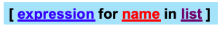
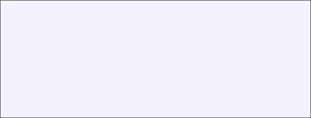
List Comprehensions replace loops!
nums = [0, 1, 2, 3, 4, 5, 6, 7, 8, 9]
# I want 'n*n' for each 'n’ in nums
squares = []
for n in nums:
for n in nums:
squares.append(x*x)
print(squares)
squares = [x*x for x in nums]
print(squares)

Slide 32
List Comprehensions replace loops!
>>> li = [3, 6, 2, 7]
>>> [elem * 2 for elem in li]
[6, 12, 4, 14]
>>> li = [('a', 1), ('b', 2), ('c', 7)]
>>> [n * 3 for (x, n) in li]
[3, 6, 21]
Notes:
CCB – todo – show how the list comprehension can be re-written as a for loop.

Slide 33
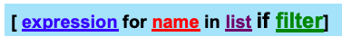
Filtered List Comprehensions
>>> li = [3, 6, 2, 7, 1, 9]
>>> [elem * 2 for elem in li if elem > 4]
[12, 14, 18]
Only 6, 7, and 9 satisfy the filter condition.
So, only 12, 14, and 18 are produced.
Notes:
.

Slide 34
List Comprehension extra for
lst1, lst2, lst3 = [1, 2, 3], [2, 3, 4], [3, 4, 5]
res = [(x, y, z) for x in lst1 if x < 2 \
for y in lst2 \
for z in lst3 if x + y + z < 8]
res = [] # translation
for x in lst1:
if x < 2:
for y in lst2:
for z in lst3:
if x + y + z < 8:
res.append((x, y, z))
# Both value of res: [(1, 2, 3), (1, 2, 4), (1, 3, 3)]
Notes:
.

Slide 35
Dictionary, Set Comprehensions
lst1 = [('a', 1), ('b', 2), ('c', 'hi')]
lst2 = ['x', 'a', 6]
d = {k: v for k,v in lst1}
s = {x for x in lst2}
d = dict() # translation
for k, v in lst1:
d[k] = v
s = set() # translation
for x in lst:
s.add(x)
# Both value of d: {'a': 1, 'b': 2, 'c': 'hi’}
# Both value of d: {'x', 'a', 6}
Notes:
.

Slide 36

Iterators
Notes:
.

Slide 37
Iterator Objects
Iterable objects can be used in a for loop because they have an __iter__ magic method, which converts them to iterator objects:
>>> k = [1,2,3]
>>> k.__iter__()
<list_iterator object at 0x104f8ca50>
>>> iter(k)
<list_iterator object at 0x104f8ca10>
Notes:
.

Slide 38
Iterators
Iterators are objects with a __next__() method:
>>> i = iter(k)
>>> next(i)
1
>>> i.__next__()
2
>>> i.next()
3
>>> i.next()
Traceback (most recent call last):
File "<stdin>", line 1, in <module>
StopIteration
Python iterators do not have a hasnext() method!
Just catch the StopIteration exception
Notes:
.

Slide 39
Iterators: The truth about for… in…
for <item> in <iterable>: <statements>
First line is just syntactic sugar for:
1. Initialize: Call <iterable>.__iter__() to create an iterator
Each iteration:
2. Call iterator.__next__() and bind <item>
2a. Catch StopIteration exceptions
To be iterable: has __iter__ method
which returns an iterator obj
To be iterator: has __next__ method
which throws StopIteration when done
Notes:
.

Slide 40

An Iterator Class
class Reverse:
"Iterator for looping over a sequence backwards"
def __init__(self, data):
self.data = data
self.index = len(data)
def __next__(self):
if self.index == 0:
raise StopIteration
self.index = self.index - 1
return self.data[self.index]
def __iter__(self):
return self
>>> for char in Reverse('spam'):
print(char)
Notes:
.

Slide 41
Iterators use memory efficiently
Eg: File Objects
>>> for line in open(“script.py”): # returns iterator
... print(line.upper())
...
IMPORT SYS
PRINT(SYS.PATH)
X = 2
PRINT(2 ** 3)
instead of
>>> for line in open(“script.py”).readlines(): #returns list
... print(line.upper())
...
Notes:
.

Slide 42

Generators
Notes:
.

Slide 43
Generators: using yield
Generators are iterators (with __next()__ method)
Creating Generators: yield
Functions that contain the yield keyword automatically return a generator when called
>>> def f(n):
... yield n
... yield n+1
...
>>>
>>> type(f)
<class 'function'>
>>> type(f(5))
<class 'generator'>
>>> [i for i in f(6)]
[6, 7]
Notes:
.

Slide 44
Generators: What does yield do?
Each time we call the __next__ method of the generator, the method runs until it encounters a yield statement, and then it stops and returns the value that was yielded. Next time, it resumes where it left off.
>>> gen = f(5) # no need to say f(5).__iter__()
>>> gen
<generator object f at 0x1008cc9b0>
>>> gen.__next__()
5
>>> next(gen)
6
>>> gen.__next__()
Traceback (most recent call last):
File "<stdin>", line 1, in <module>
StopIteration
Notes:
.

Slide 45
Generators
Benefits of using generators
Less code than writing a standard iterator
Maintains local state automatically
Values are computed one at a time, as they’re needed
Avoids storing the entire sequence in memory
Good for aggregating (summing, counting) items. One pass.
Crucial for infinite sequences
Bad if you need to inspect the individual values
Notes:
.

Slide 46
Using generators: merging sequences
Problem: merge two sorted lists, using the output as a stream (i.e. not storing it).
def merge(l, r):
llen, rlen, i, j = len(l), len(r), 0, 0
while i < llen or j < rlen:
if j == rlen or (i < llen and l[i] < r[j]):
yield l[i]
i += 1
else:
yield r[j]
j += 1
Notes:
.

Slide 47
Using generators
>>> g = merge([2,4], [1, 3, 5]) #g is an iterator
>>> while True:
... print(g.__next__())
...
1
2
3
4
5
Traceback (most recent call last):
File "<stdin>", line 2, in <module>
StopIteration
>>> [x for x in merge([1,3,5],[2,4])]
[1, 2, 3, 4, 5]
Notes:
.

Slide 48
Generators and exceptions
>>> g = merge([2,4], [1, 3, 5])
>>> while True:
... try:
... print(g.__next__())
... except StopIteration:
... print('Done’)
... break
...
1
2
3
4
5
Done
Notes:
.

Slide 49
Generator comprehensions
Review: generators are good for aggregating items.
For example, in Python 2, sum(xrange(n)) was much faster than sum(range(n))for large n
Similarly,
>>> sum(x for x in xrange(10**8) if x%5==0)
999999950000000L
which uses a generator comprehension is much faster than
>>> sum([x for x in xrange(10**8) if x%5==0])
999999950000000L
which creates the entire list before computing the sum
Notes:
.

Slide 50
Imports
Notes:
.

Slide 51
Import Modules and Files
>>> import math
>>> math.sqrt(9)
3.0
# Not as good to do this:
>>> from math import *
>>> sqrt(9) # unclear where function defined
>>> import queue as Q
>>> q = Q.PriorityQueue()
>>> q.put(10)
>>> q.put(1)
>>> q.put(5)
>>> while not q.empty():
print q.get(),
1, 5, 10
Hint: Super useful for search algorithms
Notes:
.

Slide 52
Import Modules and Files
# homework1.py
def concatenate(seqs):
return [seq for seq in seqs] # This is wrong
# run python interactive interpreter (REPL) in directory of homework1.py
>>> import homework1
>>> assert homework1.concatenate([[1, 2], [3, 4]]) == \
[1, 2, 3, 4]
Traceback (most recent call last):
File "<stdin>", line 1, in <module>
AssertionError
>>> import importlib #after fixing homework1
>>> importlib.reload(homework1)
Tip: importlib is useful for reloading code from a file.
Notes:
.

Slide 53
Import and pip
pip is the The Python Package Installer
It allows you to install a huge range of external libraries that have been packaged up and that are listed in the Python Package Index
You run it from the command line:
pip install package_name
In Google Colab, you can run command line arguments in the Python notebook by prefacing the commands with !:
!pip install nltk
Tip: if you ever get a ModuleNotFoundError then try pip install module name

Slide 54
Functions
Notes:
.

Slide 55
Defining Functions
Function definition begins with def.
Function name and its arguments.
def get_final_answer(filename):
"""Documentation String""" line1
line2
return total_counter
...
First line with less indentation is considered to be outside of the function definition.
‘return’ indicates the value to be sent back to the caller.
No declaration of types of arguments or result.
Notes:
.

Slide 56
Function overloading? No.
Python doesn’t allow function overloading like Java deos
Unlike Java, a Python function is specified by its name alone
Two different functions can’t have the same name, even if they have different numbers, order, or names of arguments
But operator overloading – overloading +, ==, -, etc. – is possible using special methods on various classes
There is partial support in Python 3, but I don’t recommend it
Python 3 – Function Overloading with singledispatch
Notes:
.

Slide 57
Default Values for Arguments
You can provide default values for a function’s arguments
These arguments are optional when the function is called
>>> def myfun(b, c=3, d="hello"):
return b + c
>>> myfun(5,3,"bob")
8
>>> myfun(5,3)
8
>>> myfun(5)
8
Non-default argument should always precede default arguments; otherwise, it reports SyntaxError
Notes:
.

Slide 58
Keyword Arguments
Functions can be called with arguments out of order
These arguments are specified in the call
Keyword arguments can be used after all other arguments.
>>> def myfun(a, b, c):
return a – b
>>> myfun(2, 1, 43) # 1
>>> myfun(c=43, b=1, a=2) # 1
>>> myfun(2, c=43, b=1) # 1
>>> myfun(a=2, b=3, 5)
File "<stdin>", line 1
SyntaxError: positional argument follows keyword argument
Notes:
.

Slide 59
*args
Suppose you want to accept a variable number of non-keyword arguments to your function.
def print_everything(*args):
"""args is a tuple of arguments passed to the fn"""
for count, thing in enumerate(args):
print('{0}. {1}'.format(count, thing))
>>> lst = ['a', 'b', 'c']
>>> print_everything('a', ’b', 'c')
0. a
1. b
2. c
>>> print_everything(*lst) # Same results as above
Notes:
.

Slide 60
**kwargs
Suppose you want to accept a variable number of keyword arguments to your function.
def print_keyword_args(**kwargs):
# kwargs is a dict of the keyword args passed to the fn
for key, value in kwargs.items(): #.items() is list
print("%s = %s" % (key, value))
>>> kwargs = {'first_name': 'Bobby', 'last_name': 'Smith'}
>>> print_keyword_args(**kwargs)
first_name = Bobby
last_name = Smith
>>> print_keyword_args(first_name="John", last_name="Doe")
first_name = John
last_name = Doe
Notes:
.

Slide 61
Python uses dynamic scope
Function sees the most current value of variables
>>> i = 10
>>> def add(x):
return x + i
>>> add(5)
15
>>> i = 20
>>> add(5)
25
Notes:
.

Slide 62
Default Arguments & Memoization
Default parameter values are evaluated only when the def statement they belong to is first executed.
The function uses the same default object each call
def fib(n, fibs={}):
if n in fibs:
print('n = %d exists' % n)
return fibs[n]
if n <= 1:
fibs[n] = n # Changes fibs!!
else:
fibs[n] = fib(n-1) + fib(n-2)
return fibs[n]
>>> fib(3)
n = 1 exists
2
Notes:
.

Slide 63
Functions are “first-class” objects
First class object
An entity that can be dynamically created, destroyed, passed to a function, returned as a value, and have all the rights as other variables in the programming language have
Functions are “first-class citizens”
Pass functions as arguments to other functions
Return functions as the values from other functions
Assign functions to variables or store them in data structures
Higher order functions: take functions as input
def compose (f, g, x):
return f(g(x))
>>> compose(str, sum, [1, 2, 3])
'6'
Notes:
.

Slide 64
Higher Order Functions: Map, Filter
>>> [int(i) for i in ['1', '2']]
[1, 2]
>>> list(map(int, ['1', '2'])) #equivalent to above
def is_even(x):
return x % 2 == 0
>>> [i for i in [1, 2, 3, 4, 5] if is_even(i)]
[2, 4]
>>> list(filter(is_even, [1, 2, 3, 4, 5])) #equivalent
>>> lambda x: x%2==0
>>> list(filter(lambda x: x%2==0, [1, 2, 3, 4, 5])) #also equivalent
Notes:
. Map applies a function to all the items in an input_list. filter creates a list of elements for which a function returns true.python
A lambda function is a small anonymous function. Syntax = lambda arguments : expression
x = lambda a : a + 10 print(x(5))

Slide 65
Sorted list of n-grams
from operator import itemgetter
def calc_ngram(inputstring, nlen):
ngram_list = [inputstring[x:x+nlen] for x in \
range(len(inputstring)- nlen + 1)]
ngram_freq = {} # dict for storing results
for n in ngram_list: # collect the distinct n-grams and count
if n in ngram_freq:
ngram_freq[n] += 1
else:
ngram_freq[n] = 1 # human counting numbers start at 1
# Can set reverse to change order of sort
# (reverse=True for ascending; reverse=False for descending)
return sorted(ngram_freq.items(), key=itemgetter(1),reverse=True)
Notes:
.

Slide 66
Classes and Inheritance
Notes:
.

Slide 67
Creating a class
class Student:
univ = "upenn" # class attribute
def __init__(self, name, dept):
self.student_name = name
self.student_dept = dept
def print_details(self):
print("Name: " + self.student_name)
print("Dept: " + self.student_dept)
student1 = Student("julie", "cis")
student1.print_details()
Student.print_details(student1)
Student.univ
Called when an object is instantiated
Every method begins with the variable self
Another member method
Creating an instance, note no self
Calling methods of an object
Notes:
. self represents the instance of the class.

Slide 68
Subclasses
A class can extend the definition of another class
Allows use (or extension) of methods and attributes already defined in the previous one.
New class: subclass. Original: parent, ancestor or superclass
To define a subclass, put the name of the superclass in parentheses after the subclass’s name on the first line of the definition.
class Nets213Student(Student):
Python has no ‘extends’ keyword like Java.
Multiple inheritance is supported.
Notes:
.

Slide 69
Constructors: __init__
Very similar to Java
Commonly, the ancestor’s __init__ method is executed in addition to new commands
Must be done explicitly
You’ll often see something like this in the __init__ method of subclasses:
parentClass.__init__(self, x, y) where parentClass is the name of the parent’s class
Student.__init__(self, x, y)
Notes:
.

Slide 70
Redefining Methods
Very similar to over-riding methods in Java
To redefine a method of the parent class, include a new definition using the same name in the subclass.
The old code in the parent class won’t get executed.
To execute the method in the parent class in addition to new code for some method, explicitly call the parent’s version of the method.
parentClass.methodName(self, a, b, c)
The only time you ever explicitly pass self as an argument is when calling a method of an ancestor. So use myOwnSubClass.methodName(a,b,c)
Notes:
.

Slide 71
Multiple Inheritance can be tricky
class A(object):
def foo(self):
print('Foo!')
class B(object):
def foo(self):
print('Foo?')
def bar(self):
print('Bar!')
class C(A, B):
def foobar(self):
super().foo() # Foo!
super().bar() # Bar!
Notes:
.

Slide 72
Special Built-In Methods and Attributes
Notes:
.

Slide 73
Magic Methods and Duck Typing
Magic Methods allow user-defined classes to behave like built in types
Duck typing establishes suitability of an object by determining presence of methods
Does it swim like a duck and quack like a duck? It’s a duck
Not to be confused with ‘rubber duck debugging’
Notes:
.

Slide 74
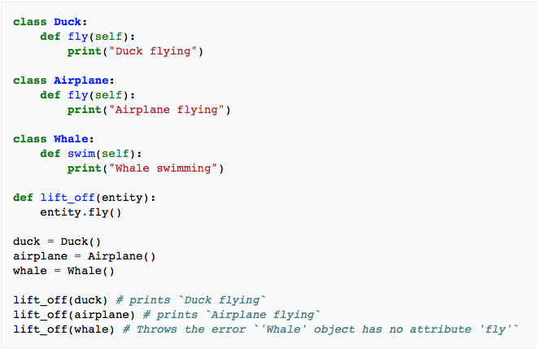
Magic Methods and Duck Typing
Notes:
.

Slide 75
Example Magic Method
class Student:
def __init__(self, full_name, age): self.full_name = full_name
self.age = age
def __str__(self): return "I'm named " + self.full_name + " – age: " + str(self.age) ...
>>> f = Student("Bob Smith", 23)
>>> print(f)
I’m named Bob Smith – age: 23
Notes:
.

Slide 76
Other “Magic” Methods
Used to implement operator overloading
Most operators trigger a special method, dependent on class
__init__: The constructor for the class.
__len__ : Define how len( obj ) works.
__copy__: Define how to copy a class.
__cmp__ : Define how == works for class.
__add__ : Define how + works for class
__neg__ : Define how unary negation works for class
Other built-in methods allow you to give a class the ability to use [ ] notation like an array or ( ) notation like a function call.
Notes:
.

Slide 77

Other Resources
Notes:
.

Slide 78
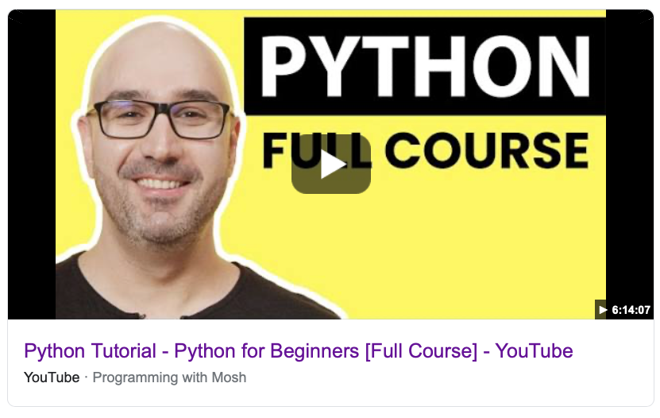
Tons of good resources on YouTube
https://www.youtube.com/watch?v=_uQrJ0TkZlc

Slide 79
Profiling, function level
Rudimentary
>>> import time
>>> t0 = time.time()
>>> code_block
>>> t1 = time.time()
>>> total = t1-t0
Timeit (more precise)
>>> import timeit
>>> t = timeit.Timer(”<statement to time>", ”<setup code>")
>>> t.timeit()
The second argument is usually an import that sets up a virtual environment for the statement
timeit calls the statement 1 million times and returns the total elapsed time, number argument specifies number of times to run it.
Notes:
.

Slide 80
Profiling, script level 1
# to_time.py
def get_number():
for x in range(500000):
yield x
def exp_fn():
for x in get_number():
i = x ^ x ^ x
return 'some result!'
if __name__ == '__main__':
exp_fn()
Notes:
.

Slide 81
Profiling, script level 1
# to_time.py
def get_number():
for x in range(500000):
yield x
def exp_fn():
for x in get_number():
i = x ^ x ^ x
return 'some result!'
if __name__ == '__main__':
exp_fn()
Notes:
.

Slide 82
Profiling, script level 2
# python interactive interpreter (REPL)
$ python -m cProfile to_time.py
500004 function calls in 0.203 seconds
Ordered by: standard name
ncalls tottime percall cumtime percall filename:lineno(function)
1 0.000 0.000 0.203 0.203 to_time.py:1(<module>)
500001 0.071 0.000 0.071 0.000 to_time.py:1(get_number) 1 0.133 0.133 0.203 0.203 to_time.py:5(exp_fn) 1 0.000 0.000 0.000 0.000 {method 'disable' of '_lsprof.Profiler' objects}
For details see https://docs.python.org/3.7/library/profile.html
Notes:
.

Slide 83
Idioms
Many frequently-written tasks should be written Python-style even though you could write them Java-style in Python
Remember beauty and readability!
Notes:
.

Slide 84
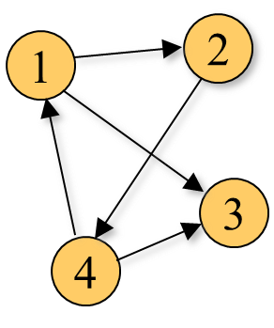
A directed graph class
>>> d = DiGraph([(1,2),(1,3),(2,4),(4,3),(4,1)])
>>> print(d)
1 -> 2
1 -> 3
2 -> 4
4 -> 3
4 -> 1
Notes:
.

Slide 85
A directed graph class
>>> d = DiGraph([(1,2),(1,3),(2,4),(4,3),(4,1)])
>>> [v for v in d.search(1, set())]
[1, 2, 4, 3]
>>> [v for v in d.search(4, set())]
[4, 3, 1, 2]
>>> [v for v in d.search(2, set())]
[2, 4, 3, 1]
>>> [v for v in d.search(3, set())]
[3]
search method returns a generator for the nodes that can be reached from a given node by following arrows “from tail to head”
Notes:
.

Slide 86
Define a class
The DiGraph constructor
class DiGraph:
def __init__(self, edges):
self.adj = {}
for u, v in edges:
if u not in self.adj: self.adj[u] = [v]
else: self.adj[u].append(v)
def __str__(self):
return '\n'.join(['%s -> %s'%(u,v) \
for u in self.adj for v in self.adj[u]])
>>> d = DiGraph([(1,2),(1,3),(2,4),(4,3),(4,1)])
>>> d.adj
{1: [2, 3], 2: [4], 4: [3, 1]}
The constructor builds a dictionary (self.adj) mapping each node name to a list of node names that can be reached by following one edge (an “adjacency list”)
Iterate over a list
Define a magic method
List Comprehension
Notes:
.

Slide 87
The search method
Memoize with function variable
class DiGraph:
...
def search(self, u, visited):
# If we haven't already visited this node...
if u not in visited:
# yield it
yield u
# and remember we've visited it now.
visited.add(u)
# Then, if there are any adjacent nodes...
if u in self.adj:
# for each adjacent node...
for v in self.adj[u]:
# search for all nodes reachable from *it*...
for w in self.search(v, visited):
# and yield each one.
yield w
Use a generator
Notes:
.

